Slide 1
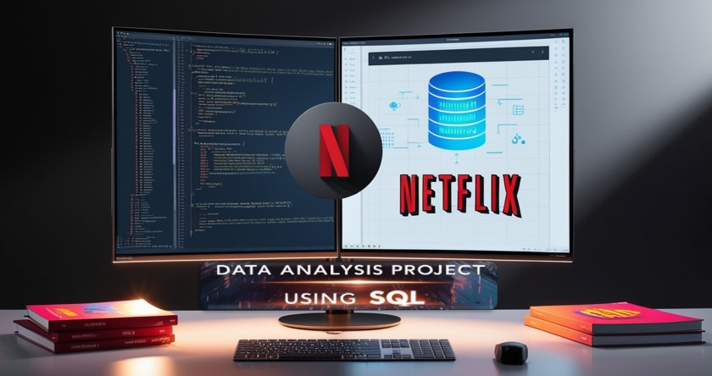
Created by:- MAINAK MUKHERJEE | Email: subha.mainak@gmail.com

Slide 2

Project Overview
This project entails an in-depth analysis of Netflix's movies and TV shows dataset using SQL. The aim is to extract valuable insights and address key business questions derived from the data. This README provides a comprehensive overview of the project’s objectives, the business challenges tackled, the solutions implemented, significant findings, and concluding thoughts.
Objectives
Analyze the distribution of content types (movies vs. TV shows).
Identify the most prevalent ratings for both movies and TV shows.
Examine and categorize content by release years, countries, and durations.
Explore and classify content based on specific criteria and keywords.
The data for this project is sourced from a Kaggle dataset: Kaggle Netflix Dataset

Slide 3
Data Queries for Netflix Content Analysis: A SQL Approach
Count the total number of Movies and TV Shows.
Top 3 most common Ratings for Movies and TV Shows.
List of all movies released in the year of 2020 and 2021.
Top 5 countries with the most content on Netflix.
Identification of the top 10 longest-duration movies.
Content added in the last 5 years.
All the movies and TV shows by the renowned animation director 'Rajiv Chilaka’!
All the TV shows with more than 5 seasons.
The average number of content released in India on Netflix for each year.
All the movies that are listed as documentaries.
All the content without a director.
Top 10 Directors with the most titles, who have the most movies or shows on Netflix.
Content released trend: The number of movies released each year.
The number of titles featuring specific well-known actors, like 'Leonardo DiCaprio' or 'Scarlett Johansson’.
Content with the longest descriptions: display the title and description to understand content marketing trends.

Slide 4

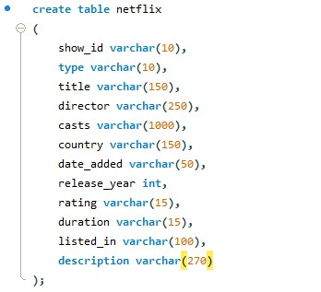
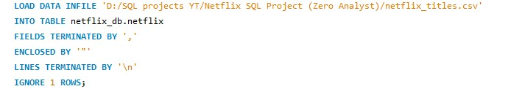
Database Creation:
Schema:
Data Import:

Slide 5


1. Count the total number of Movies and TV Shows.
Query:
Output:

Slide 6
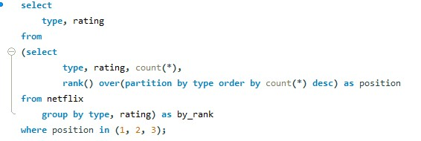
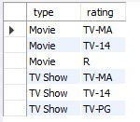
2. Top 3 most common Ratings for Movies and TV Shows.
Query:
Output:

Slide 7
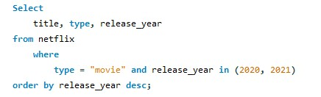
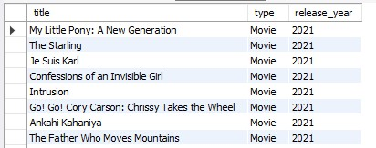
3. List of all movies released in the year of 2020 and 2021.
Query:
Output:
794 row(s) returned

Slide 8
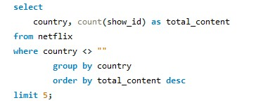
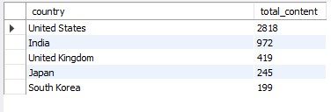
4. Top 5 countries with the most content on Netflix.
Query:
Output:

Slide 9
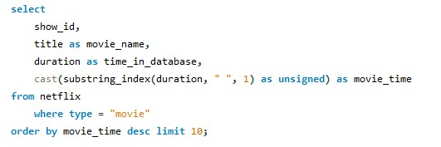
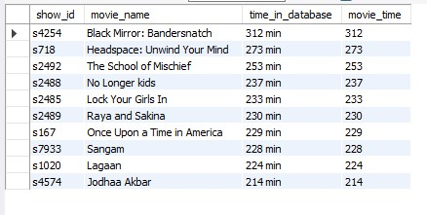
5. Identification of the top 10 longest-duration movies.
Query:
Output:

Slide 10
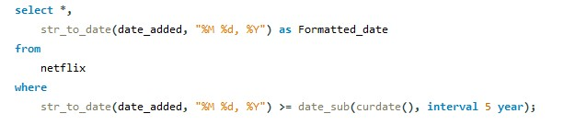
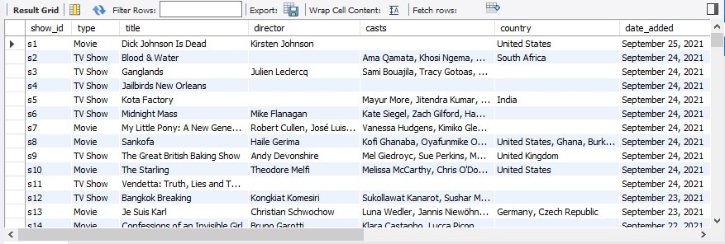
6. Content added in the last 5 years.
Query:
Output:
1000 row(s) returned

Slide 11
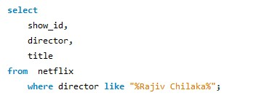
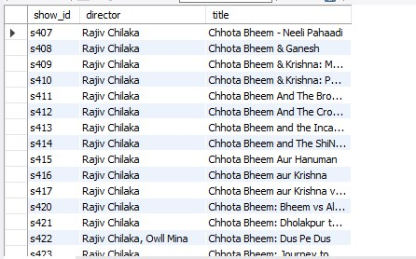
7. All the movies and TV shows by the renowned animation director 'Rajiv Chilaka’!
Query:
Output:
22 row(s) returned

Slide 12
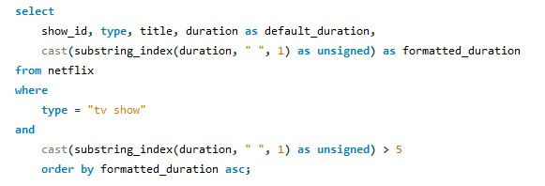
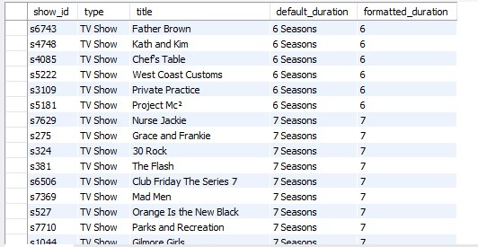
8. All the TV shows with more than 5 seasons.
Query:
Output:
99 row(s) returned

Slide 13
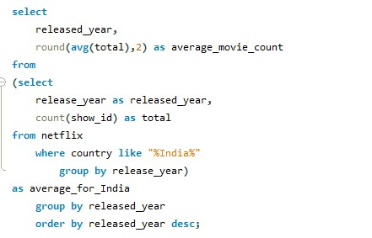
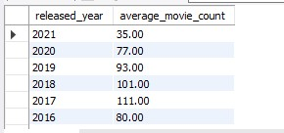
9. The average number of content released in India on Netflix for each year.
Query:
Output:
57 row(s) returned

Slide 14
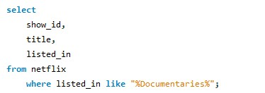
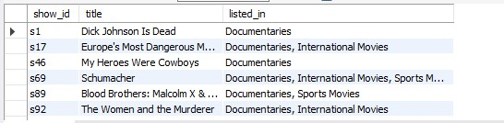
10. All the movies that are listed as documentaries.
Query:
Output:
869 row(s) returned

Slide 15

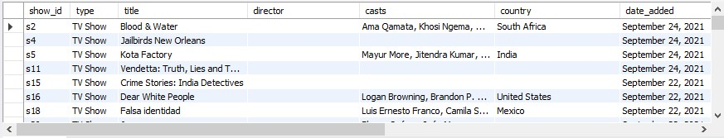
11. All the content without a director.
Query:
Output:
2634 row(s) returned

Slide 16
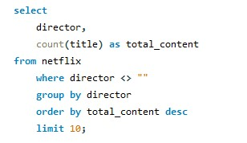
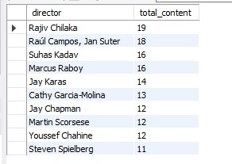
12. Top 10 Directors with the most titles, who have the most movies or shows on Netflix.
Query:
Output:

Slide 17
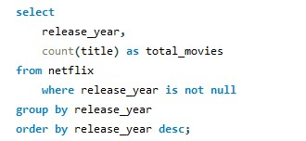
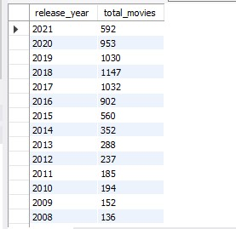
13. Content released trend: The number of movies released each year.
Query:
Output:
74 row(s) returned

Slide 18
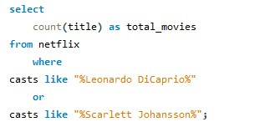

14. The number of titles featuring specific well-known actors, like
'Leonardo DiCaprio' or 'Scarlett Johansson’.
Query:
Output:

Slide 19
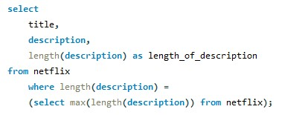
15. Content with the longest descriptions: display the title and description to understand content marketing trends.
Query:
Output:

Slide 20

Conclusion
Content Distribution: The dataset features a diverse collection of movies and TV shows, showcasing a variety of genres and ratings.
Popular Ratings: Analyzing the most frequent ratings reveals insights into Netflix’s target audience and the type of content that appeals to them.
Geographical Trends: Highlighting top countries, such as India, and the average number of content releases provides a regional perspective on Netflix's distribution strategy.
Content Categorization: Grouping titles by specific keywords offers a deeper understanding of the types of content available on the platform.
Overall, this analysis presents a comprehensive overview of Netflix’s content landscape, providing valuable insights that can guide content strategy and decision-making.

